Slide 1
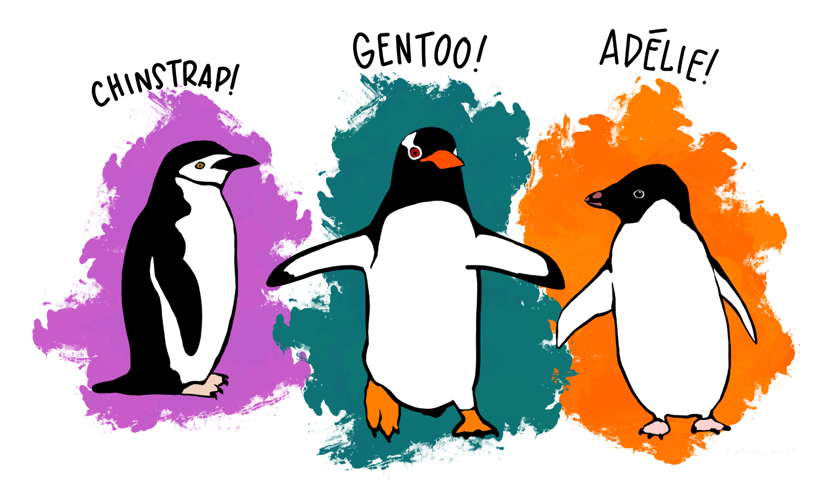
Learning from Penguins
How to identify the species

Slide 2
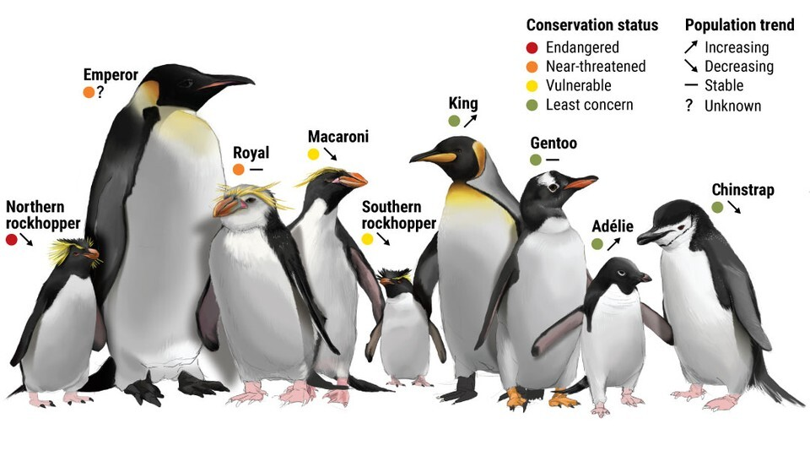

Slide 3
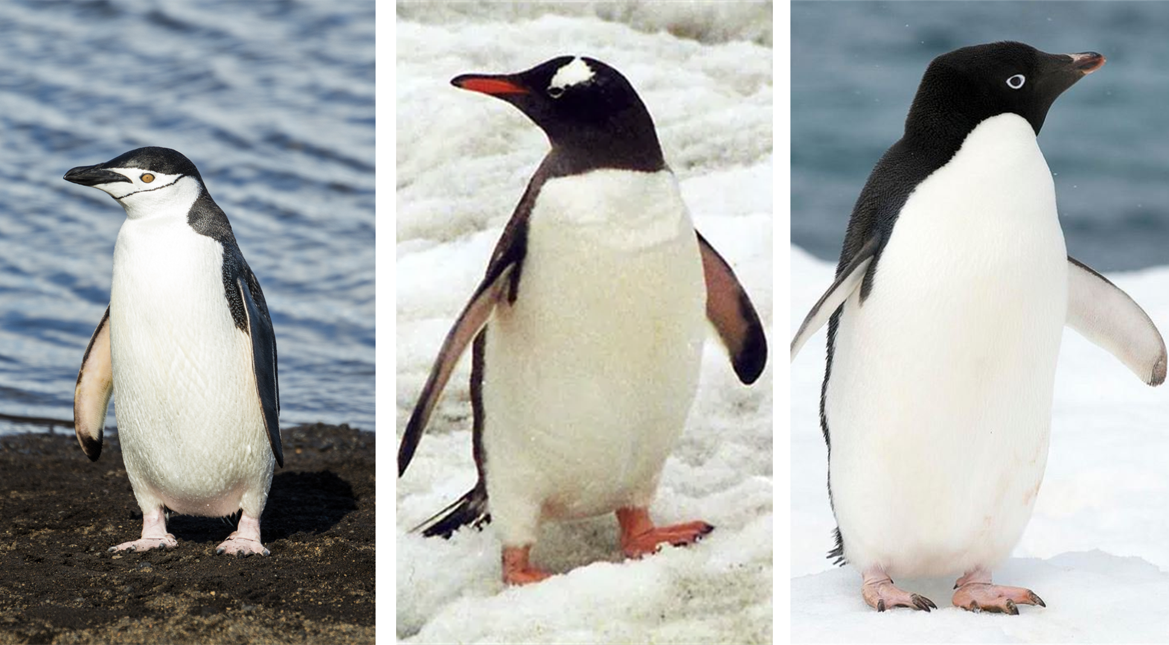
Chinstrap
Gentoo
Adelie

Slide 4
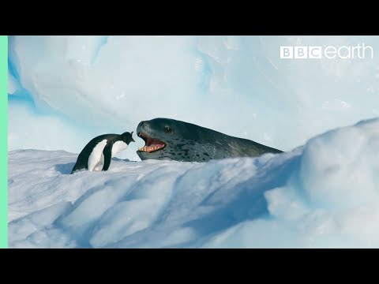
Gentoo

Slide 5
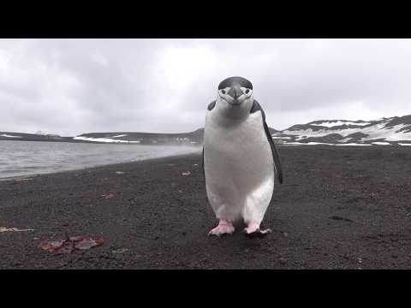
Chinstrap

Slide 6
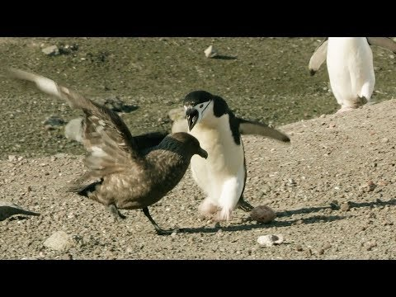
Chinstrap

Slide 7
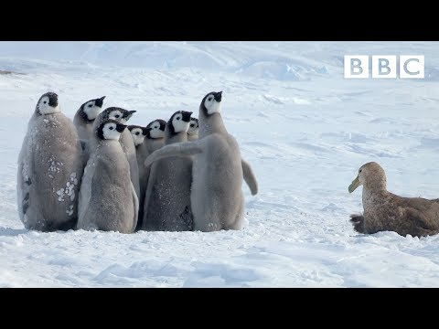
Adelie saves emperor penguin chicks

Slide 8
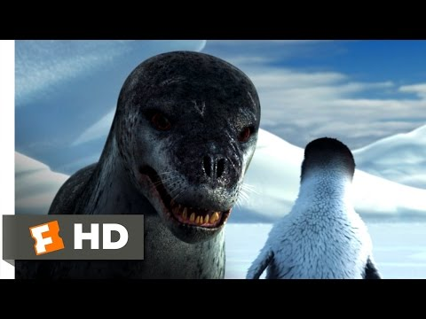
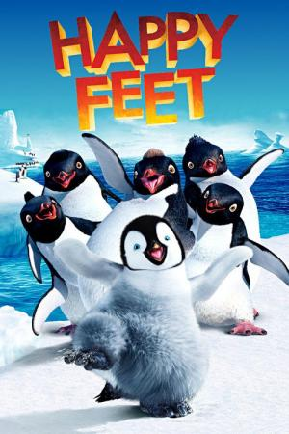
Movie Happy Feet

Slide 9
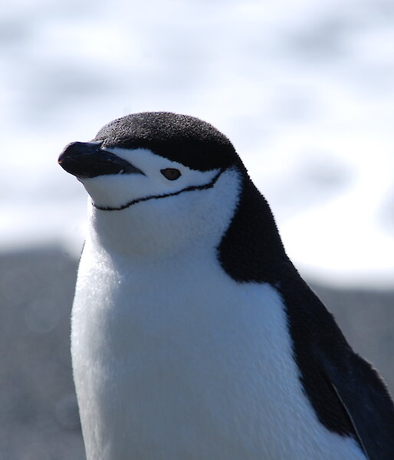
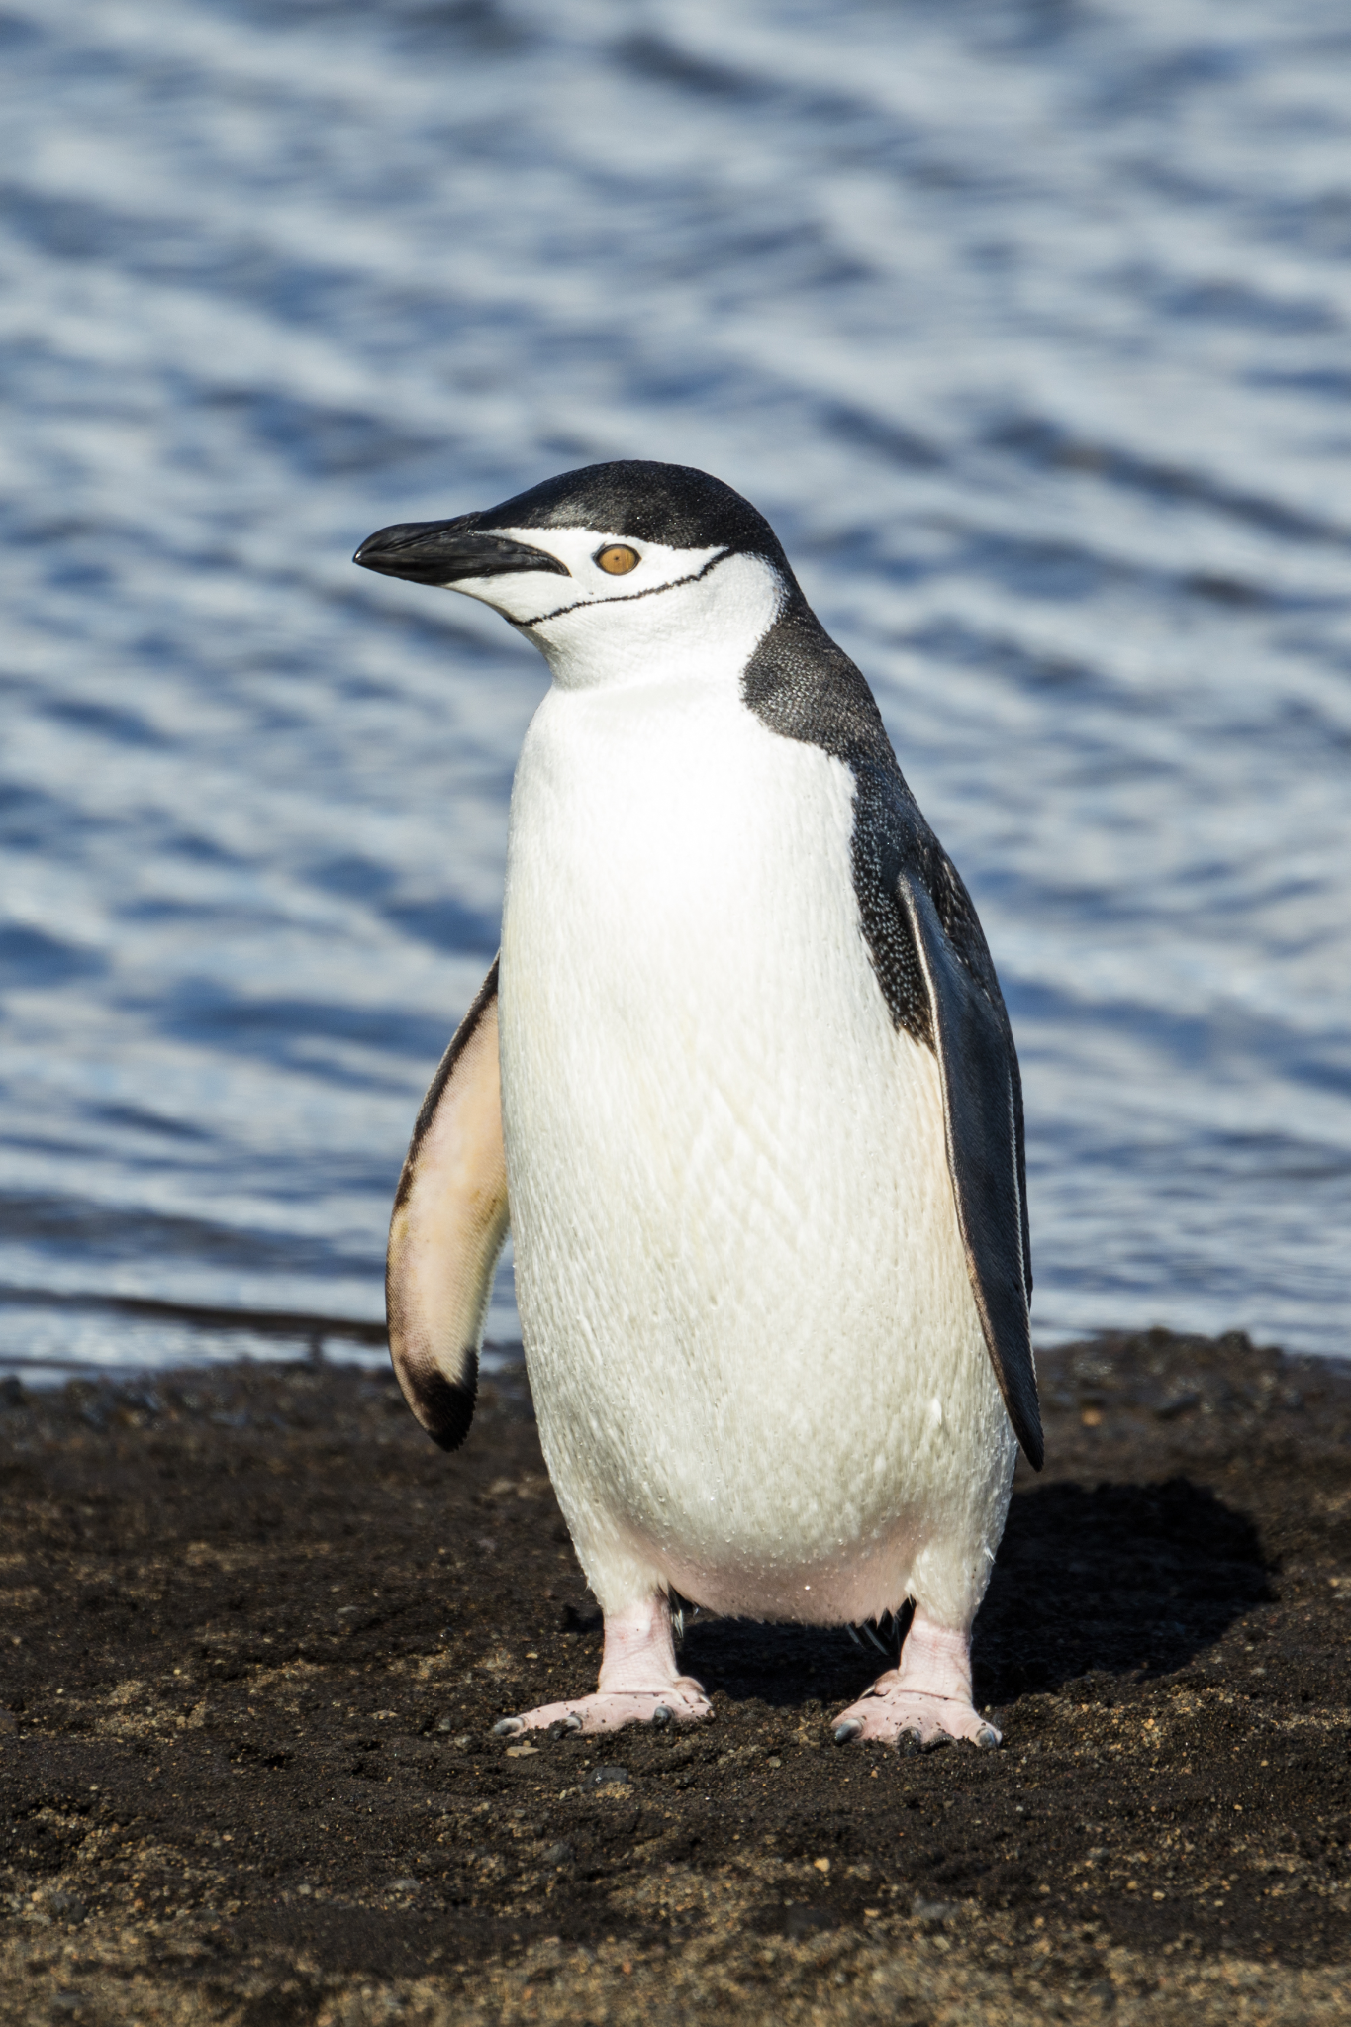
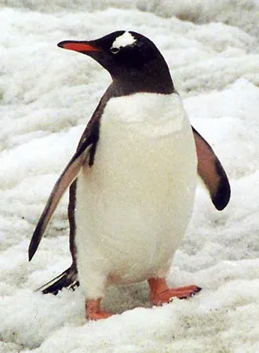
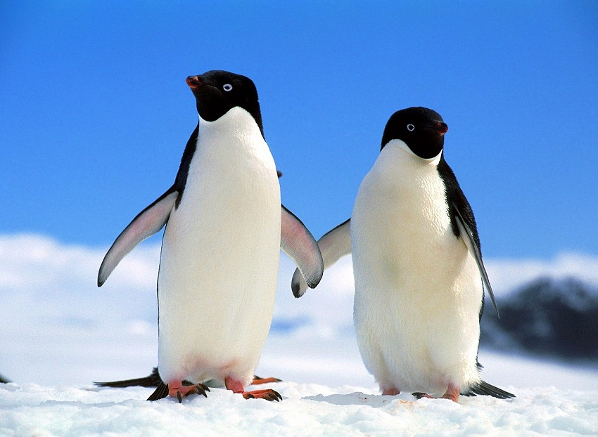
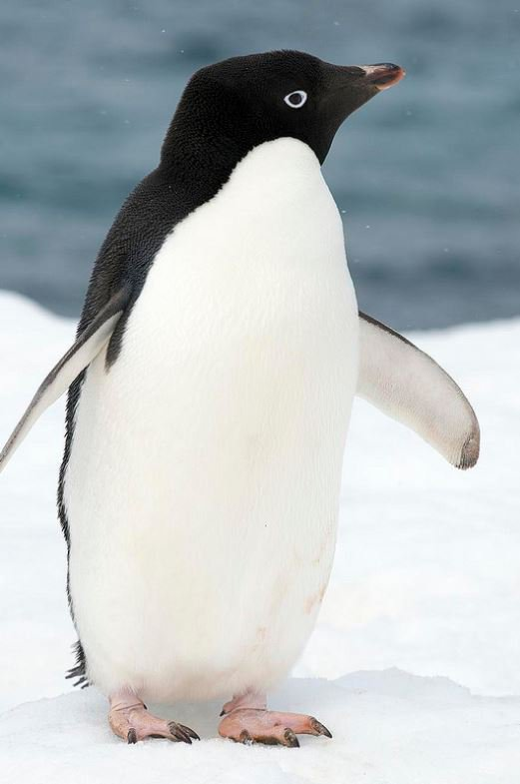
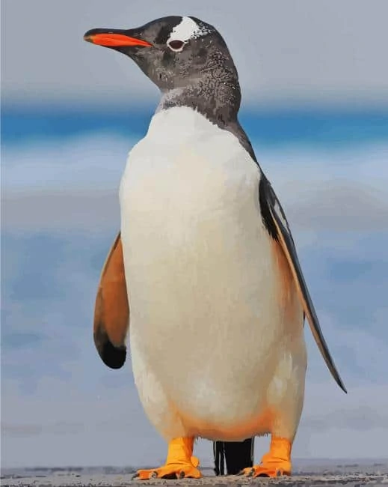
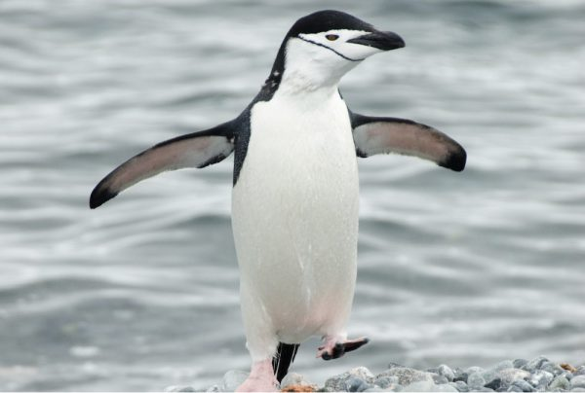
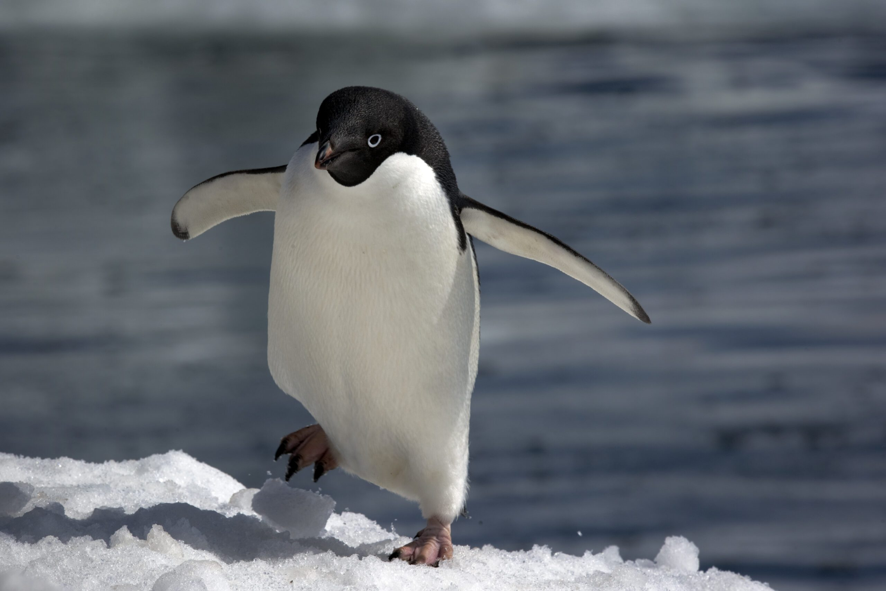
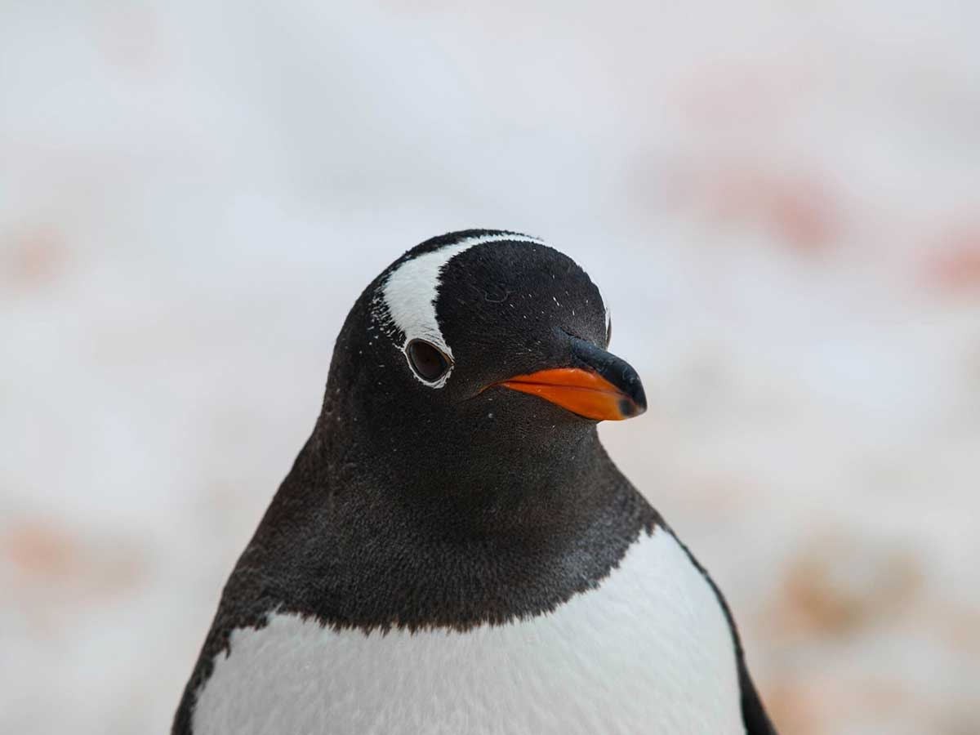

Slide 10
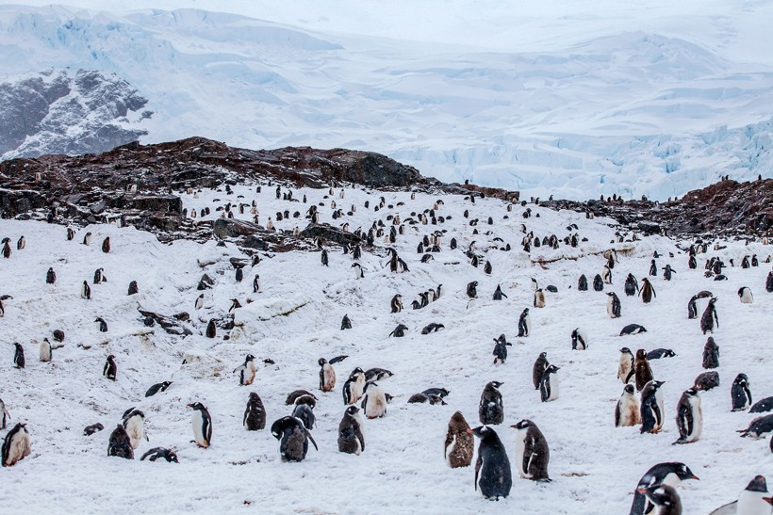
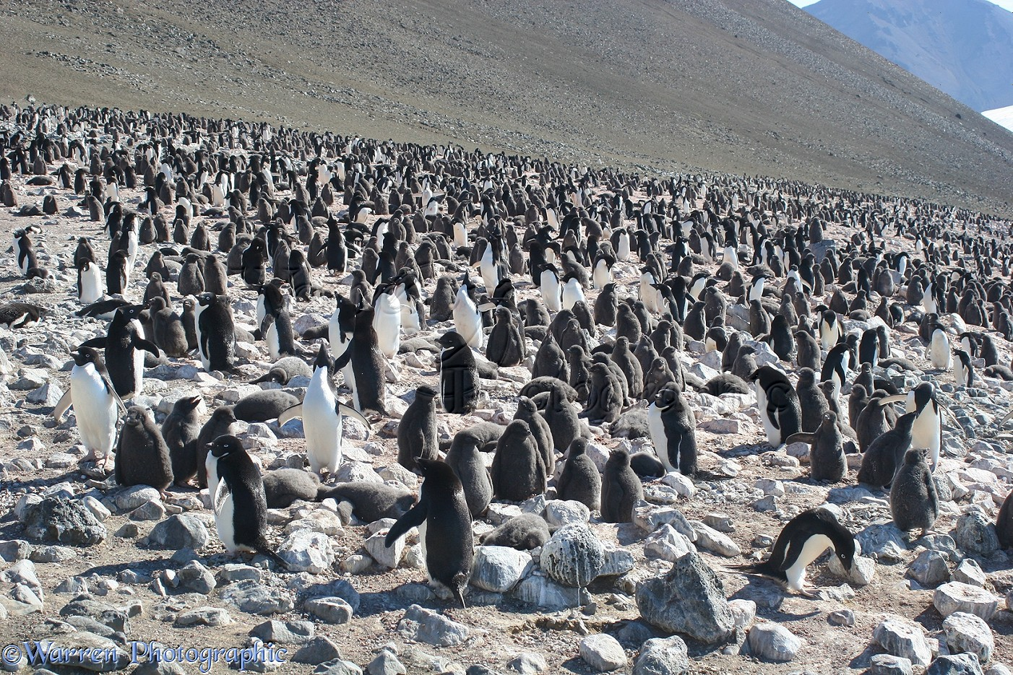
What if we have hundreds and thousands of penguins?
It would be hard to keep hundreds and thousands of pictures around.

Slide 11
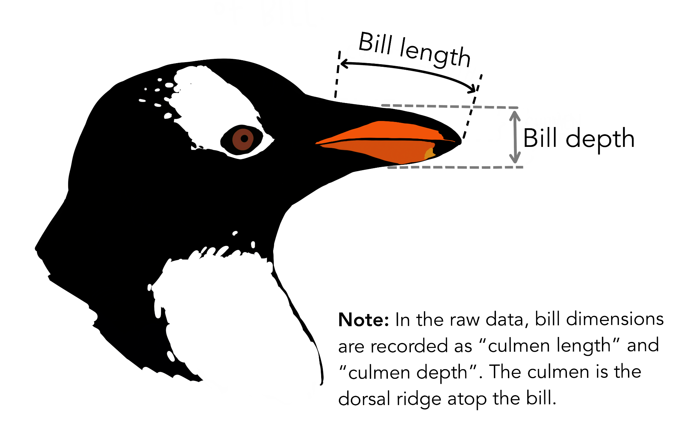
Data
ID | Species | Island | Bill Length (mm) | Bill Depth (mm) | Flipper Length (mm) | Body Mass (g) | Sex | Year
1 | Adelie | Torgersen | 39.1 | 18.7 | 181 | 3750 | male | 2007
2 | Adelie | Torgersen | 39.5 | 17.4 | 186 | 3800 | female | 2007
3 | Adelie | Torgersen | 40.3 | 18.0 | 195 | 3250 | female | 2007
… | … | … | … | … | … | … | … | …
344 | Chinstrap | Dream | 50.2 | 18.7 | 198 | 3775 | female | 2009

Slide 12
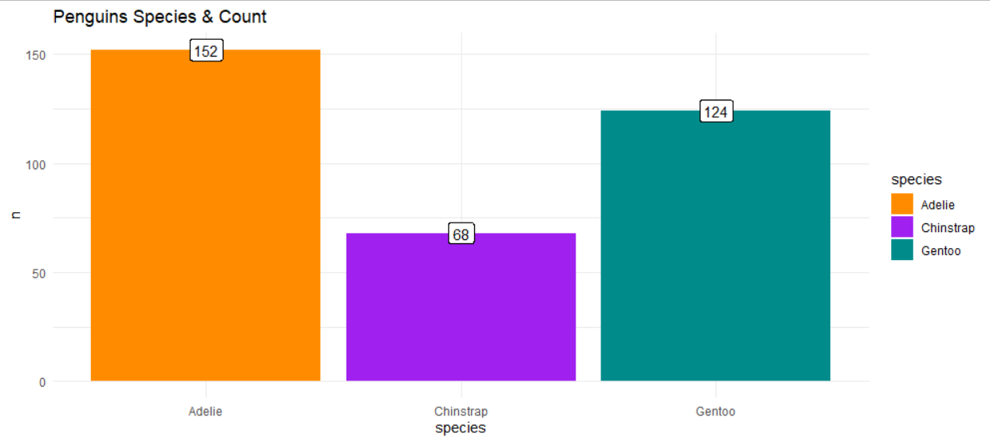
Data

Slide 13
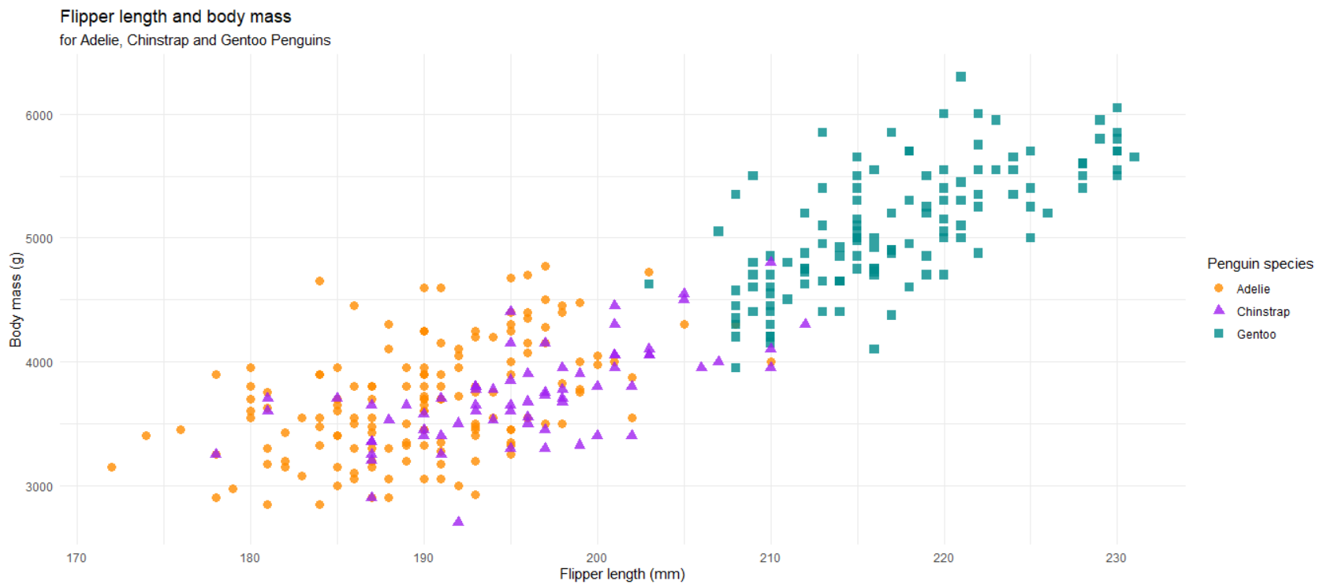
Data

Slide 14
Explore Dataset
https://isenseproject.org/
With iSense

Slide 15
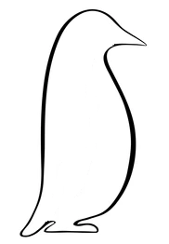
kNN
k-nearest neighbor
Chinstrap
Adelie
Chinstrap

Slide 16
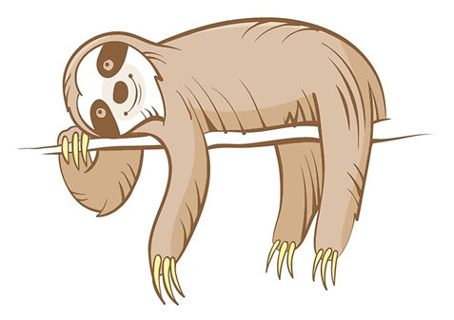
What is kNN?
kNN: k-nearest neighbor
kNN is one of the simplest classification method
kNN is lazy!
Little to no work is done before classification
Calculation is delayed until absolutely necessary

Slide 17
What is k?
“k” is the number of nearest neighbors that we consider
mystery penguin species?
k=1
k=3
Chinstrap
Adelie
Adelie
Adelie: 1 vote
Chinstrap: 2 votes
Chinstrap

Slide 18
Similarity
Straight line distance
D

Slide 19
What happens when k is different?
?

Slide 20
k=1
?

Slide 21
k=3
?

Slide 22
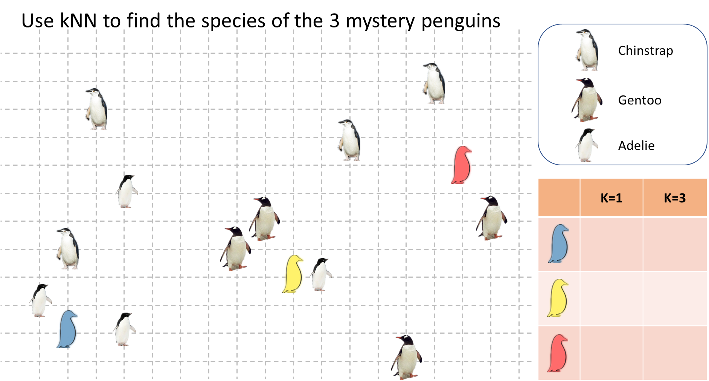

Slide 23
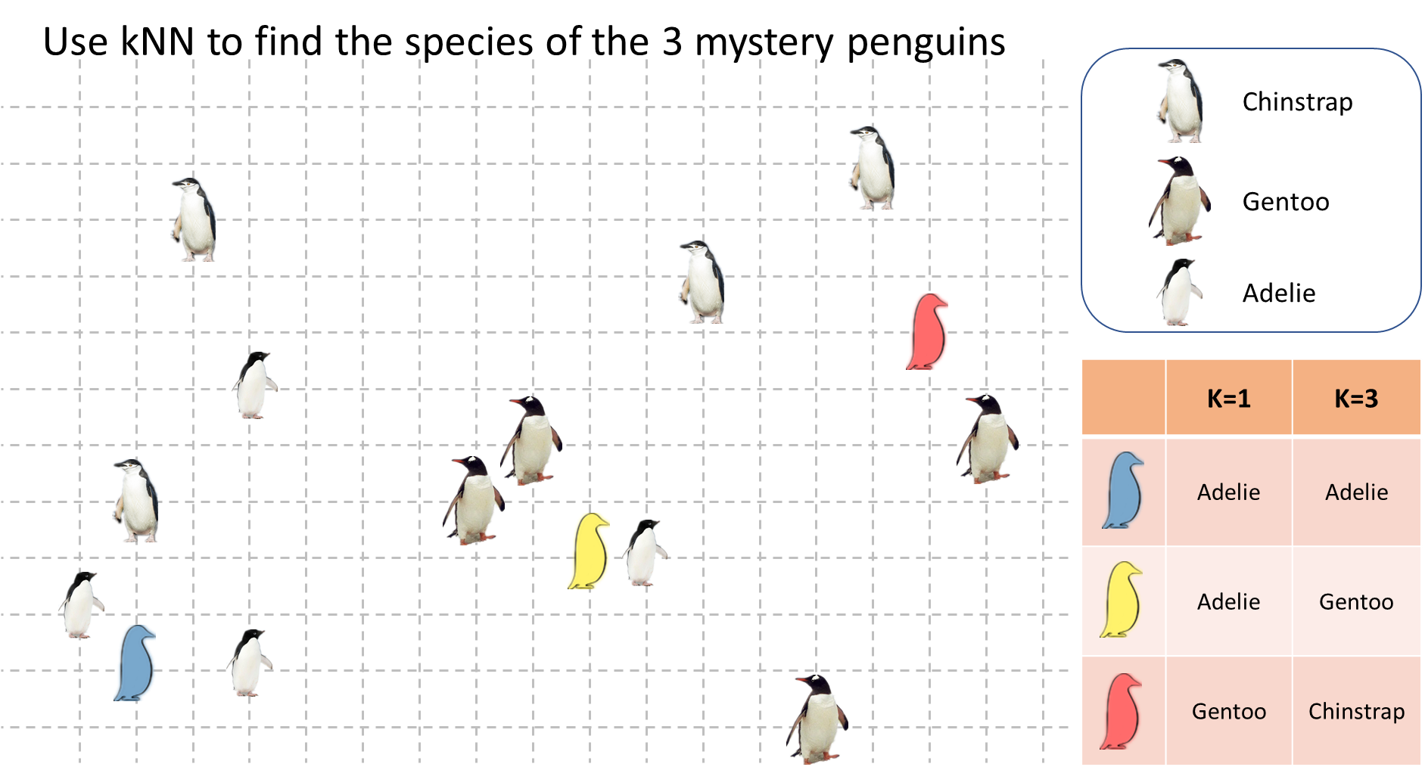

Slide 24
Complete post-survey for Day 5 – penguin
tinyurl.com/2p8nzzrp

Slide 25
k-means
https://www.naftaliharris.com/blog/visualizing-k-means-clustering/
Notes:
https://www.naftaliharris.com/blog/visualizing-k-means-clustering/

Slide 26
What is k-means?
K-means is an unsupervised learning method, meaning we don’t need labeled data
K-means is one of many clustering methods
We can use it to create clusters based on what the machines sees in the data

Slide 27
Data
ID | Species | Island | Bill Length (mm) | Bill Depth (mm) | Flipper Length (mm) | Body Mass (g) | Sex | Year
1 | Adelie | Torgersen | 39.1 | 18.7 | 181 | 3750 | male | 2007
2 | Adelie | Torgersen | 39.5 | 17.4 | 186 | 3800 | female | 2007
3 | Adelie | Torgersen | 40.3 | 18.0 | 195 | 3250 | female | 2007
… | … | … | … | … | … | … | … | …
344 | Chinstrap | Dream | 50.2 | 18.7 | 198 | 3775 | female | 2009

Slide 28
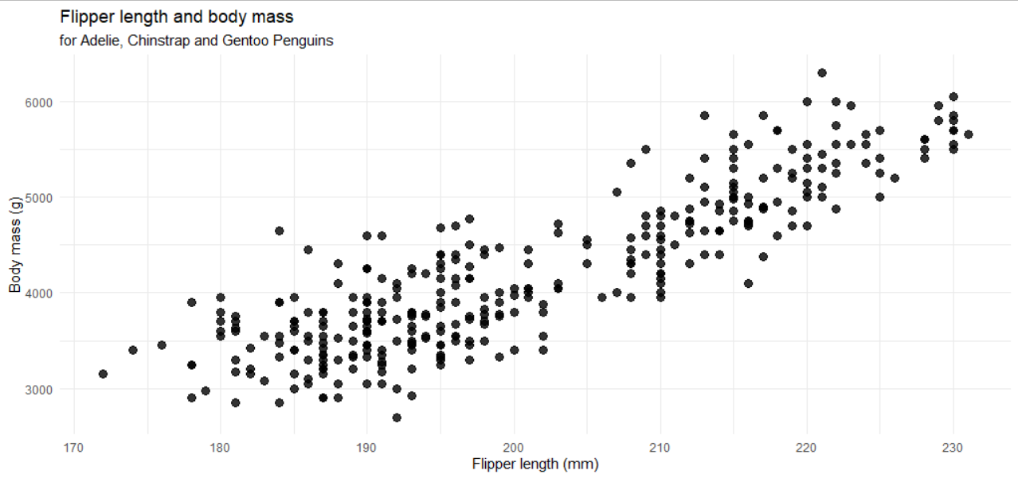
No labels

Slide 29
What is k?
k is the number of clusters/groups we allow the computer to find
We need to give computer a k before the computer analyze the data

Slide 30
The goal of k-means
Find similarity within one cluster.
Find dissimilarity between clusters.

Slide 31
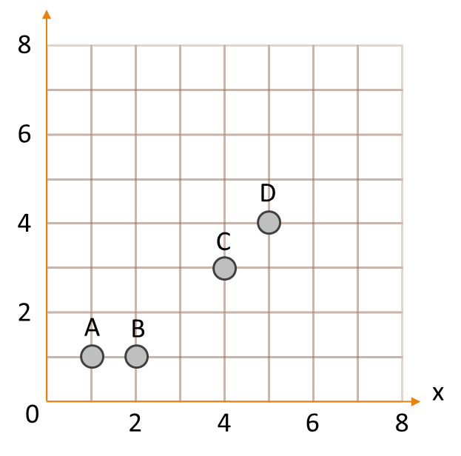
K-means process

Slide 32
K-means: step 1
Which center are each point closest to?
Points
A
B
C
D
✅
✅
✅
✅

Slide 33
K-means: step 1
Does this look reasonable?
We then shift the cluster centers.
And check which new cluster center the data are assigned to.

Slide 34
K-means: step 3
Which center are each point closest to?
Points
A
B
C
D
✅
✅
✅
✅

Slide 35
K-means: result
Does this look reasonable?
Do we need to shift the cluster centers?

Slide 36
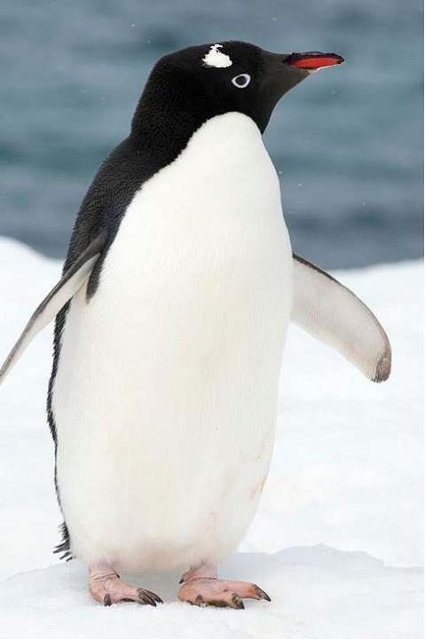
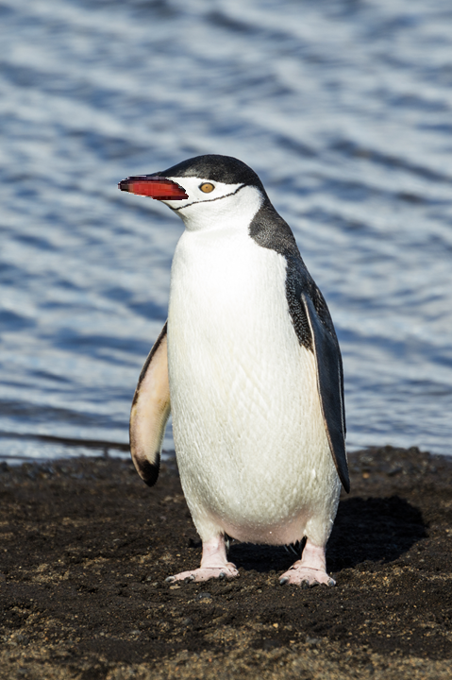
What happens when k in k-means is different?
k=2

Slide 37
What happens when k in k-means is different?
k=3

